Slide 1
- CXR-LT 2024: 4th in Subtask 2, 5th in Subtask 1 - Ensemble of ConvNeXt V2 and MaxViT for Long-Tailed CXR Classification with View-Based Aggregation
Yosuke Yamagishi, Shouhei Hanaoka
Graduate School of Medicine, The University of Tokyo

Slide 2
Introduction
Our solution focuses on leveraging SOTA models, pretraining with other CXR dataset, handling imbalance, and view-based prediction aggregation.
Model Choice: MaxViT and ConvNeXt V2 for their high performance on ImageNet.
CXR Pretraining: ImageNet-pretrained model was further pretrained on the NIH CXR dataset to enhance chest finding recognition.
Handling Imbalance Classes: Asymmetric loss to address the long-tailed distribution of findings.
View-based Prediction Aggregation: Combined predictions from frontal and lateral views using weighted averaging.
MICCAI Challenges 2024 CXR-LT | CXR Classification with ConvNeXt V2 and MaxViT using View-Based Aggregation

Slide 3
Method: Model Choice
ConvNeXt V2 provides strong local feature extraction, effective for capturing detailed patterns in chest X-rays (S Woo, et al. 2023).
MaxViT combines local and global feature learning, allowing it to identify complex structures in the images (Z Tu, et al. 2022).
By ensembling these models, we aimed to enhance the detection of diverse findings in CXR classification.
MICCAI Challenges 2024 CXR-LT | CXR Classification with ConvNeXt V2 and MaxViT using View-Based Aggregation

Slide 4
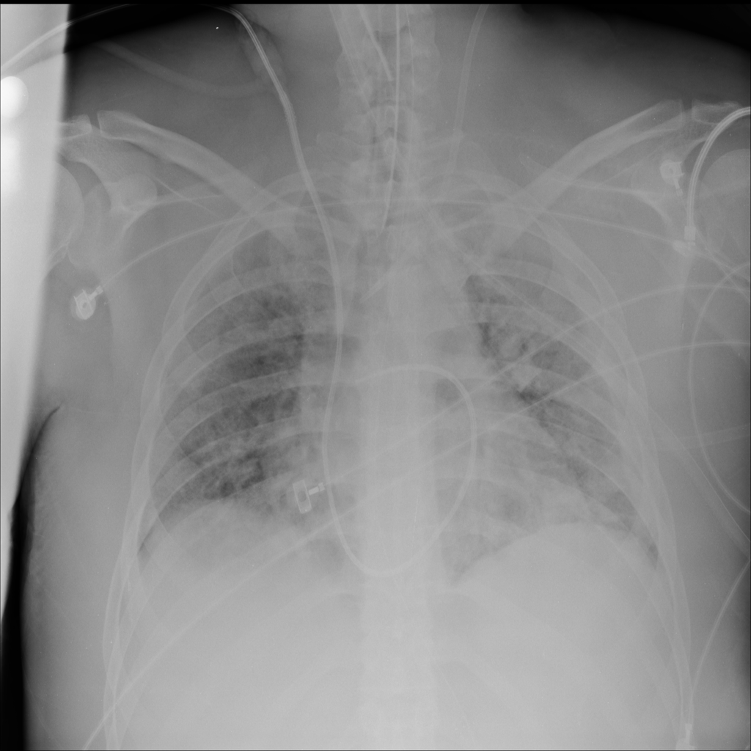
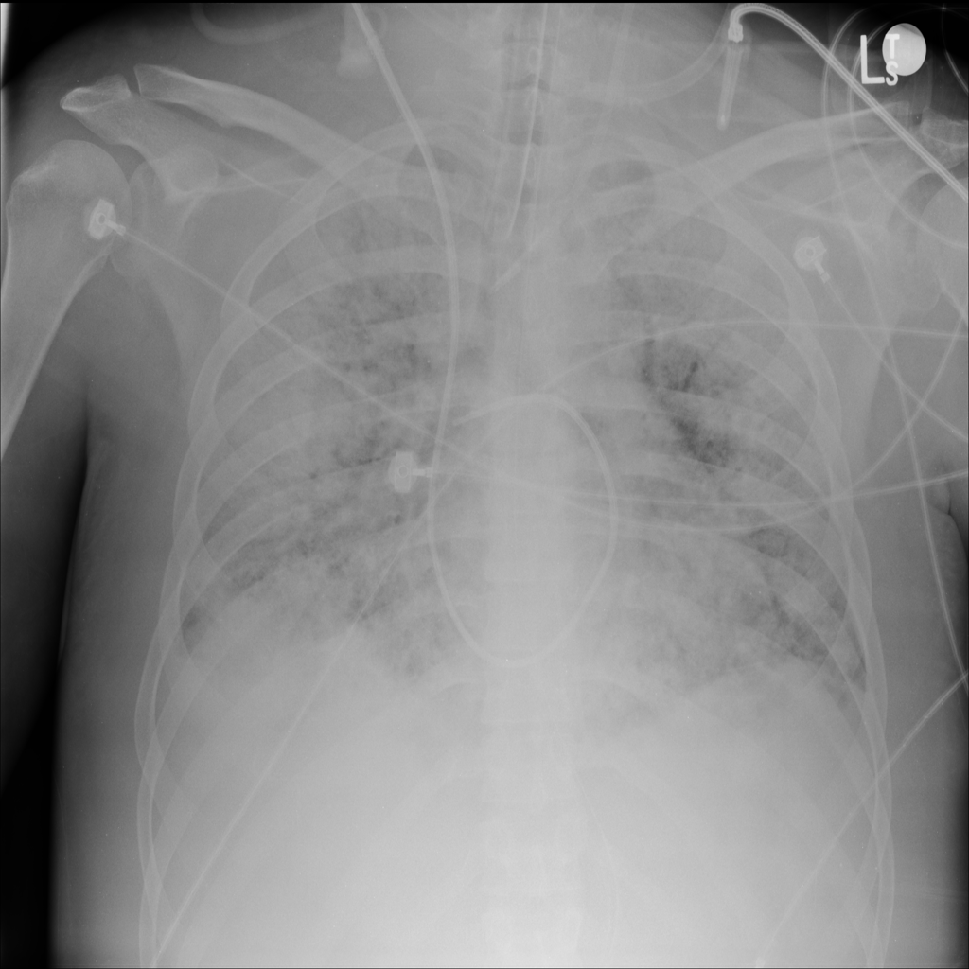
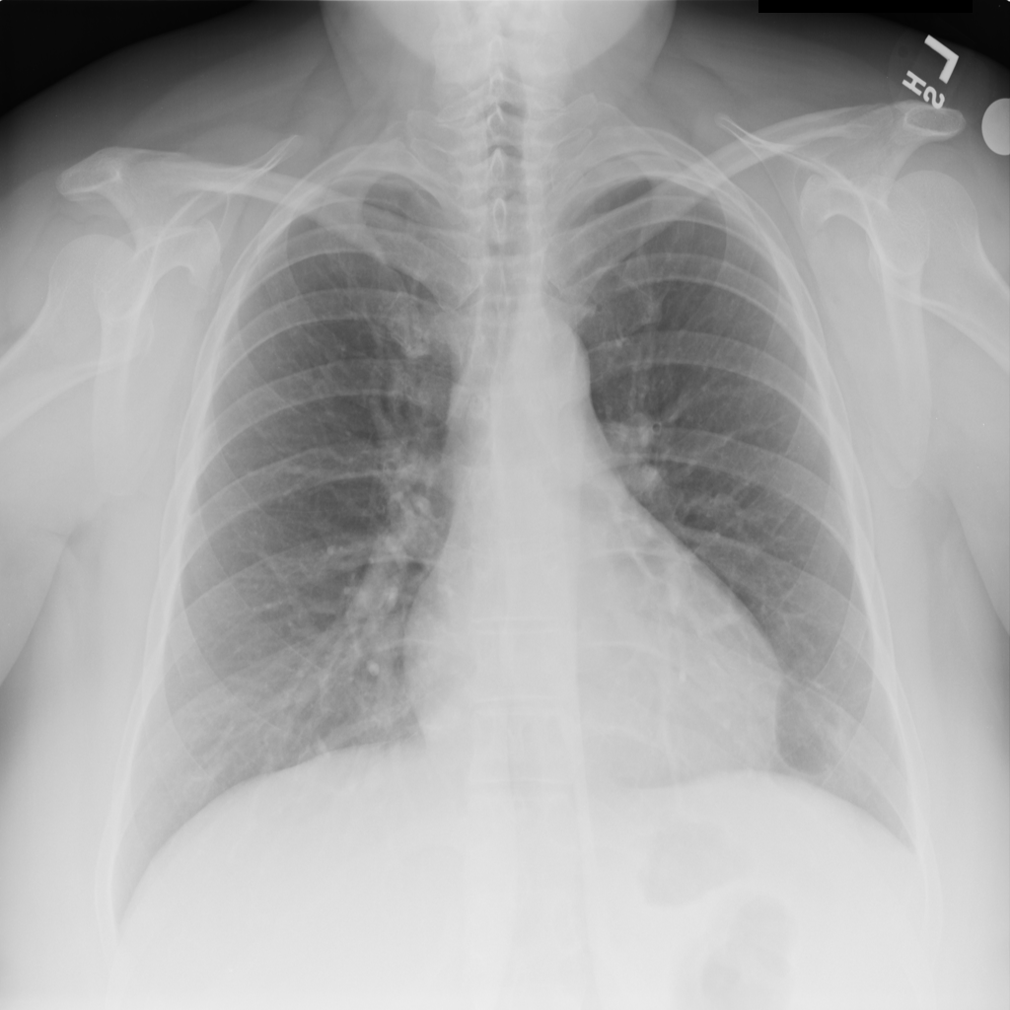
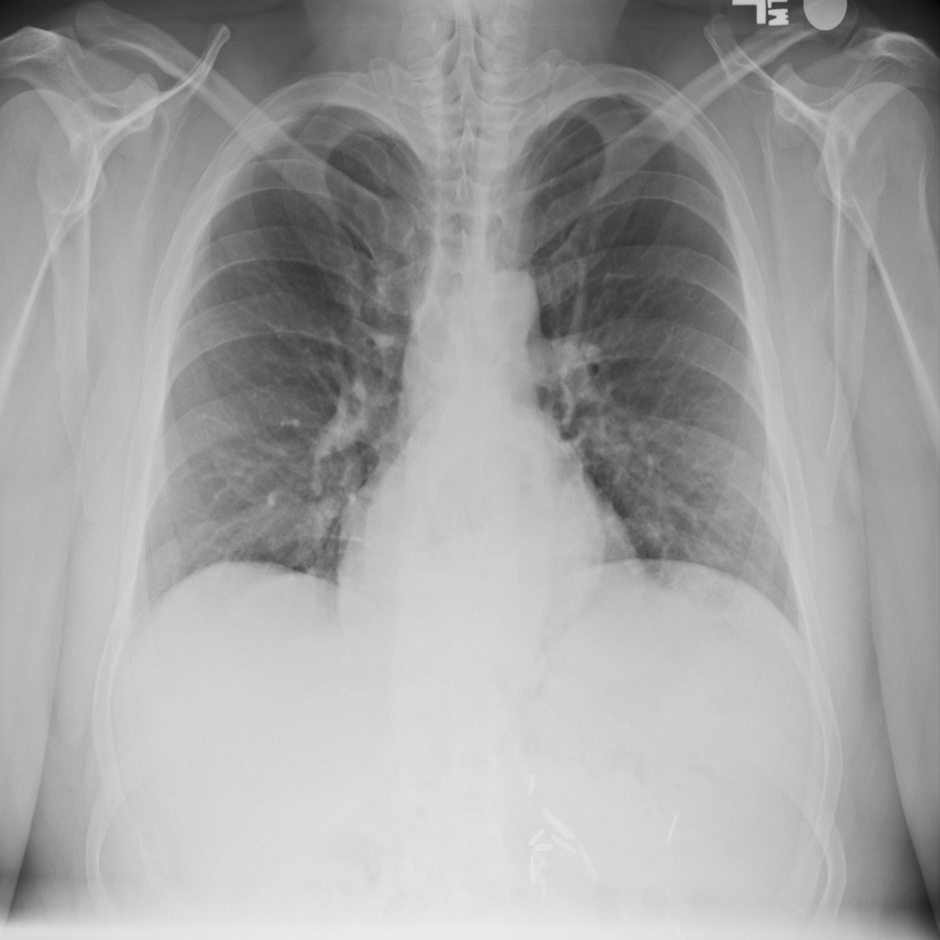
Method: CXR Pretraining
The models used were ConvNeXt V2 Tiny and MaxViT Tiny, both pretrained on ImageNet.
Additionally, MaxViT was further pretrained using the NIH Chest X-ray dataset (112,120 images).
The NIH data was split into a 19:1 ratio for training and validation using existing labels, and the model with the best mean Average Precision (mAP) was selected.
NIH Chest X-ray Dataset (Wang X, et al. 2017)
MICCAI Challenges 2024 CXR-LT | CXR Classification with ConvNeXt V2 and MaxViT using View-Based Aggregation

Slide 5
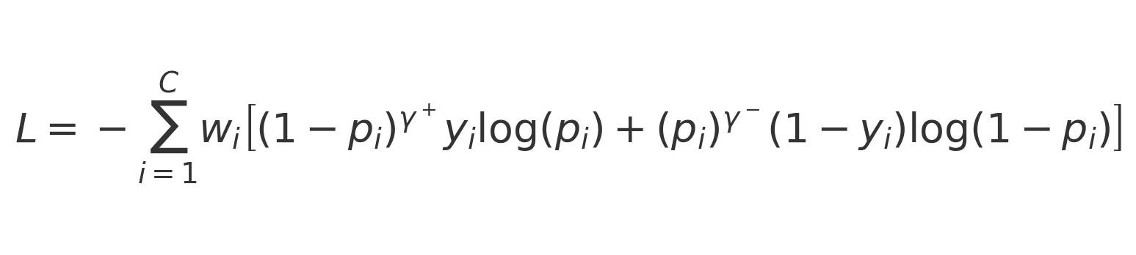
Method: Asymmetric Loss with Class Weights
Uses the same loss function as last year’s 1st solution (D Kim. 2023).
Tackles class imbalance by giving more weight to rare classes (tail classes).
Uses asymmetric focusing to prioritize difficult cases differently for positive and negative samples.
Enhances model performance in long-tailed classification.
MICCAI Challenges 2024 CXR-LT | CXR Classification with ConvNeXt V2 and MaxViT using View-Based Aggregation

Slide 6
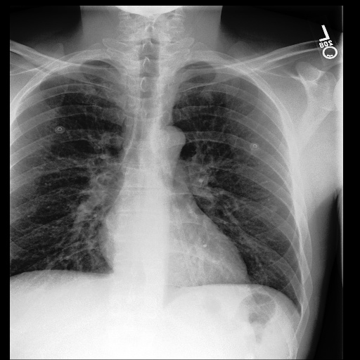
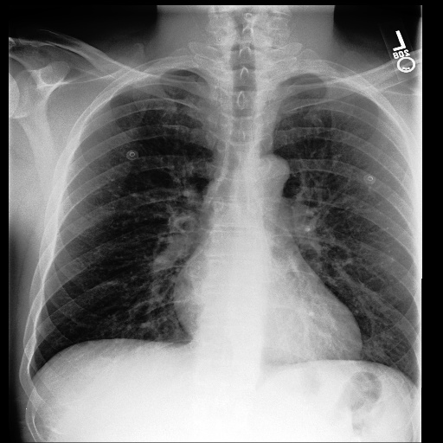
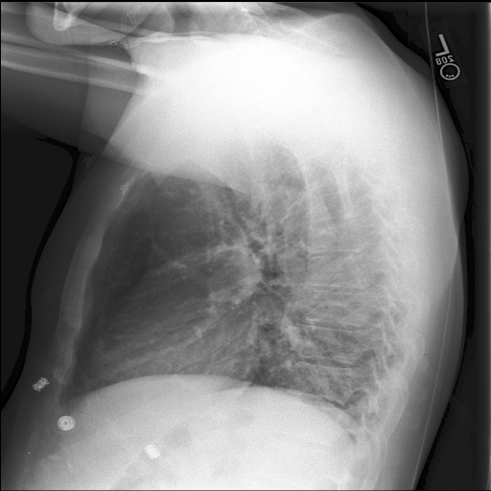
Method: View-Based Prediction Aggregation
Frontal View
MIMIC's CXR images include multiple frontal and lateral views for each study.
Aggregating predictions per study improved performance in last year's solution (Y Yamagishi, S Hanaoka. 2023, D Kim, 2023).
Averaged predictions for each frontal and lateral view, then combined them using a weighted average for the final prediction.
Averaging by each view
Probability 0
Weighted Averaging
Probability 1
Final
Prediction
Lateral View
Probability 2
MICCAI Challenges 2024 CXR-LT | CXR Classification with ConvNeXt V2 and MaxViT using View-Based Aggregation
Notes:
lateral viewの画像は差し替え予定。

Slide 7
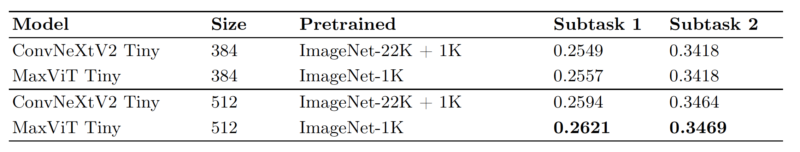
Results: Comparison of Model Architectures
* The evaluation metric is mAP. Results are from the development phase, as reported on the CodaLab leaderboard, with view-based prediction aggregation performed at a 5:5 ratio.
In all models, performance improved with an input size of 512 compared to 384.
MaxViT generally outperformed ConvNeXtV2 across most sizes and subtasks.
MICCAI Challenges 2024 CXR-LT | CXR Classification with ConvNeXt V2 and MaxViT using View-Based Aggregation

Slide 8
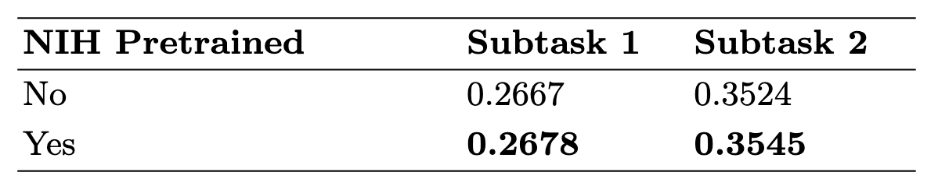
Results: Effect of CXR Pretraining
Evaluated the performance changes of MaxViT Tiny, pretrained on ImageNet with an input size of 512, based on the presence or absence of NIH CXR dataset pretrained weights.
Using the NIH pretrained weights improved both Subtask 1 and Subtask 2 by approximately 0.001 to 0.002.
MICCAI Challenges 2024 CXR-LT | CXR Classification with ConvNeXt V2 and MaxViT using View-Based Aggregation

Slide 9
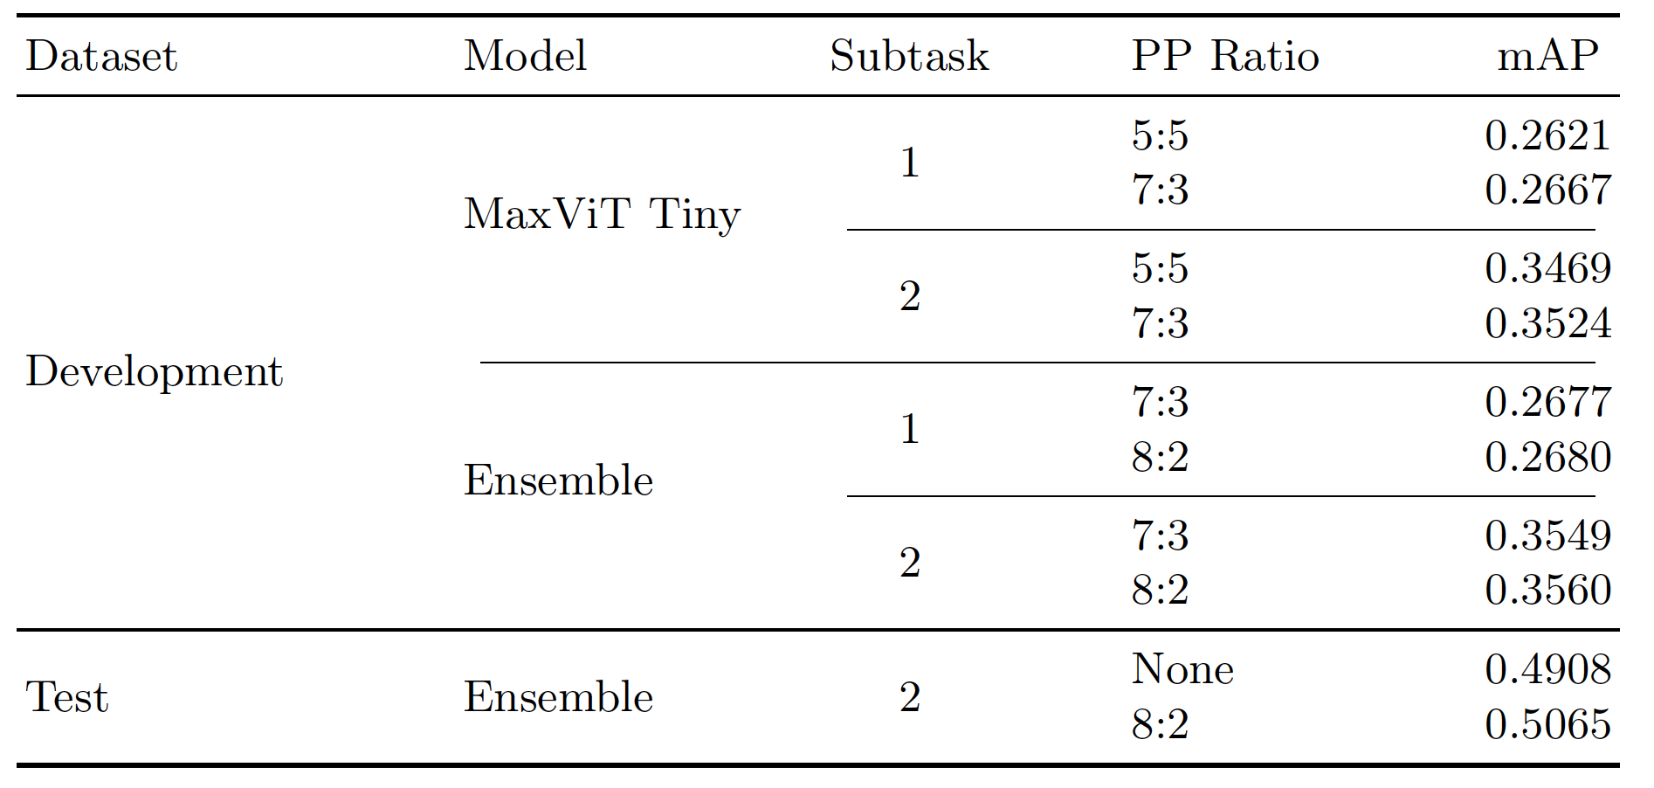
Results: Effect of View-based Prediction Aggregation
View-based prediction aggregation improved scores for both subtasks.
Weighting frontal views more heavily (e.g., 7:3, 8:2) outperformed balanced weighting (5:5).
Likely because lateral views often obscure important findings.
MICCAI Challenges 2024 CXR-LT | CXR Classification with ConvNeXt V2 and MaxViT using View-Based Aggregation

Slide 10
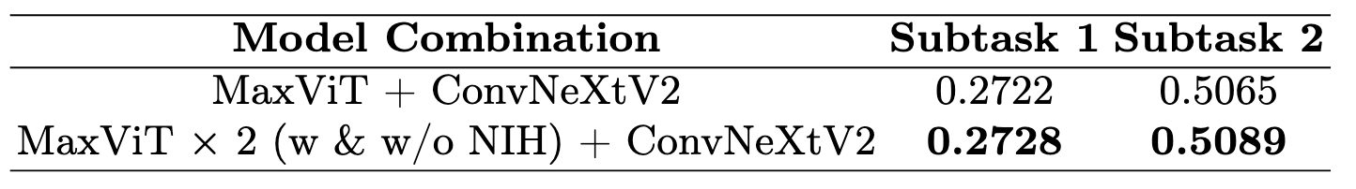
Results: Performance on Test Dataset
In both subtasks, the ensemble of two models showed an improvement in mAP when the NIH-pretrained MaxViT was included.
We achieved favorable rankings: 5th place in Subtask 1 and 4th place in Subtask 2.
MICCAI Challenges 2024 CXR-LT | CXR Classification with ConvNeXt V2 and MaxViT using View-Based Aggregation

Slide 11
Discussion
The existing high-performance model also demonstrated good performance in the classification of CXR findings with a long-tail distribution.
Although a simple approach, the straightforward aggregation of predictions from both frontal and lateral views proved effective.
A comparison of loss functions was not conducted, indicating the need for further investigation.
MICCAI Challenges 2024 CXR-LT | CXR Classification with ConvNeXt V2 and MaxViT using View-Based Aggregation

